Slide 1
Supersize America
Team 11
By: Harry Heublum, Tom Duszyk, Lena Kim, Jack Phinney

Slide 2
Motivation and Summary
Project Description: Our project is to uncover patterns and trends between fast food restaurants and census data. We will examine the correlation and relationship between most popular fast food restaurants and demographic data such as professions, poverty rate, and unemployment rate.
Questions:
Most popular FFR by state?
Correlation between white collar jobs and FFR?
Correlation between unemployment rate and FFR?
Correlation between income and FFR?
We were able to solve the first question, most popular FFR by state. The other questions we found no correlation between the data. We found California was the most popular state for FFR. This was not that surprising because California is also the biggest state by population.

Slide 3
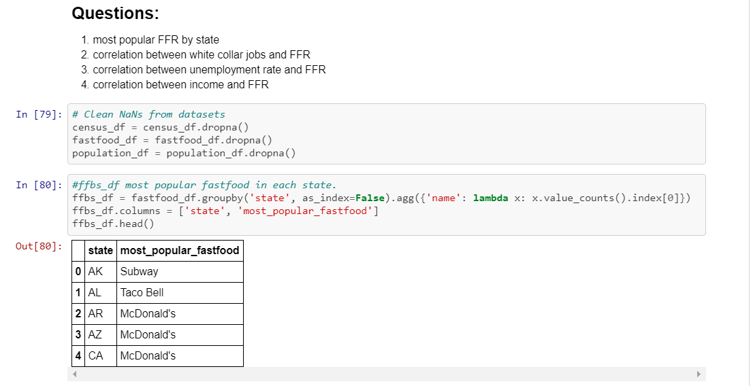
Questions and Data
To answer our questions we needed to combine 2 datasets. We had to combine the fast food restaurants across America dataset with the US census demographic dataset. We found both of these datasets on Kaggle.

Slide 4
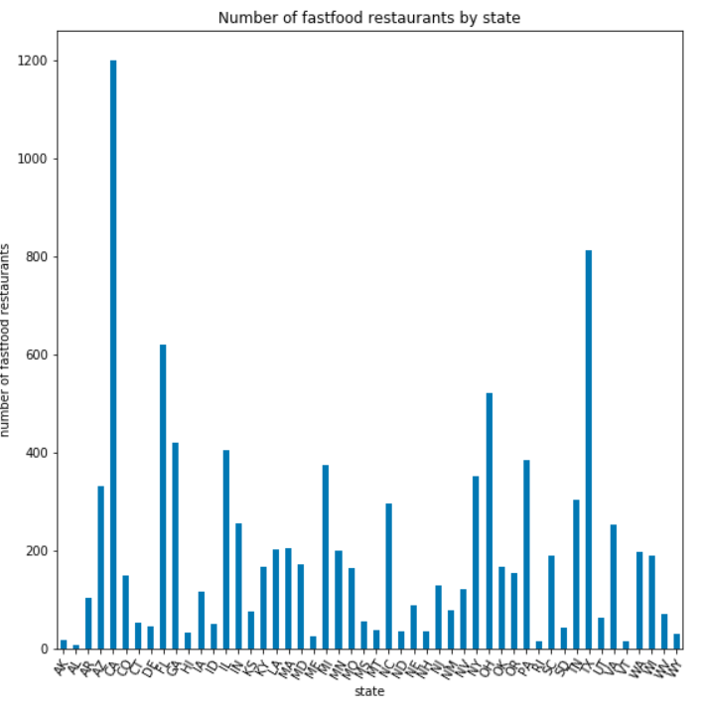
Data Cleanup and Exploration
To clean up the datasets we had to convert the datasets to csv’s. Then we imported the datasets using pandas. After that we created dataframes and plotted some figures using matplotlib. We didn’t expect Hawaii to have more fast foods than Alaska because Hawaii is a much smaller state by land mass. But actually Alaska is the smaller state by population because it is so far up North that not many want to live in the state with the cold weather. Furthermore, less fast foods were made in Alaska because there is not as many people who want it.

Slide 5
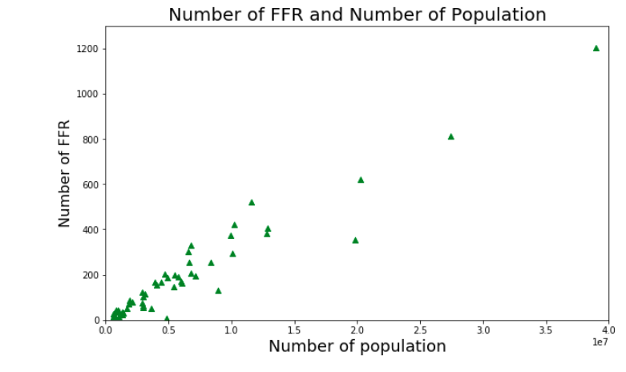
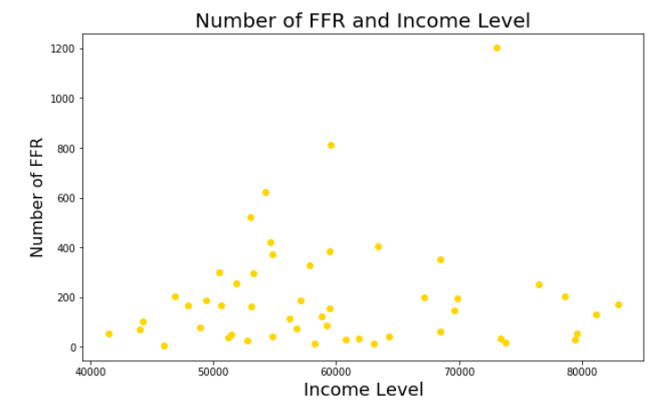
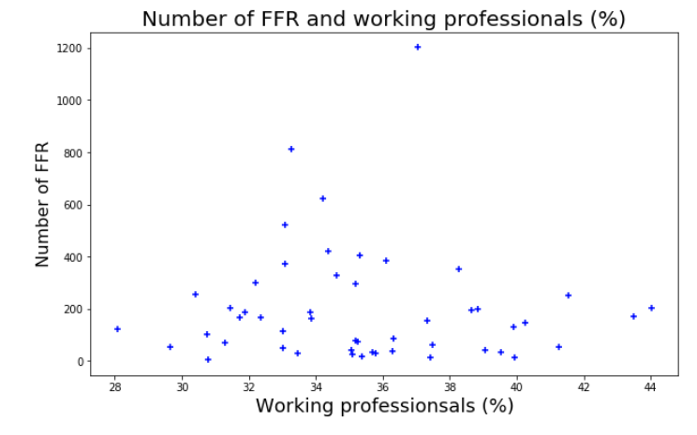
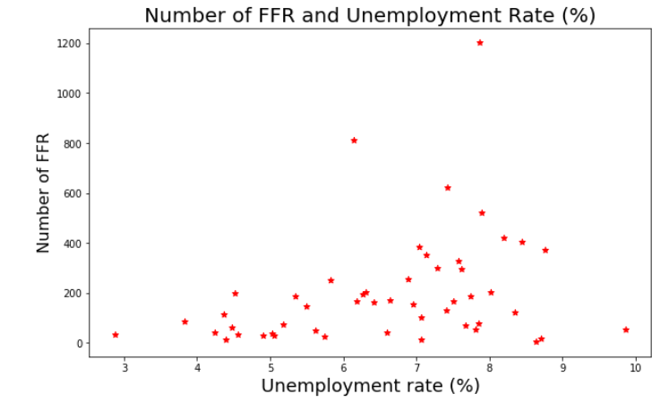
Data Analysis

Slide 6
Discussion
We found what we expected to find. The biggest state by population (California) had the most fast foods and the smallest state by population (Alaska) had one of the least amount of fast foods. We also found that McDonald’s was the most popular fast food restaurant in the dataset. This wasn’t that much of a surprise since McDonald’s is so widely known in America. McDonald’s serves the classic American food which appeals to a lot of Americans. McDonald’s is also kid-friendly which grows its popularity.
We found Houston, Texas was the city with most fast food restaurants. This also wasn’t much of a surprise since in our analysis of states, Texas was the second most popular state for fast foods.

Slide 7
Post Mortem
Some difficulties that came up were merging the two datasets. We had to convert the Census dataset ‘state name’ to its ‘state abbreviation’. We found someone who converted all state names to state abbreviations so we didn’t have to type this all out in python.
Some additional questions that came up were: is there a correlation between cities population and the number of FFR? We didn’t have enough time to figure out this question but from the analysis we did of states, we would also suspect a correlation between cities population and the number of FFR.

Slide 8
Questions
Open-floor Q&A with the audience

